Slide 1


Slide 2

Operating Systems Linux

Slide 3
Overview
By the end of this module you should have developed an understanding of:
partitions and file systems
the Linux directory tree
navigating to files and directories
reading and setting file and directory permissions.
using wildcard characters ( * and ?)
creating, moving, and removing files and directories.

Slide 4
Partitions
A partition is a logical section of a physical disk.
Each partition contains a file system.
Each file system has a root directory
These concepts apply to both Windows and Linux systems.
The difference lies in how disk partitions are presented to users and administrators.
Disk 1, Partition 1
Disk 1, Partition 2

Slide 5
Partitions
For Unix style systems, each file system holds part (or all) of a directory tree.
Linux partitions are identified with names such as “hda1” and “sda1”

Slide 6
Partitions
In general Linux partition names have the form
hdxn or sdxn
where x is a letter that uniquely identifies the drive, starting with a
and n is a number that uniquely identifies a partition on a specific drive, starting with 1
For example, sda identifies the first available hard drive, and sda1 identifies the first partition on the first hard drive.

Slide 7
Partitions
Traditionally, hdxn indicates an IDE device and sdxn indicated a SCSI device.
SATA devices should also appear as sdxn
/dev/sda1
/dev/sda2

Slide 8
Partitions
How a hard drive is partitioned depends on number of users, planned use, ...
Linux requires a single partition to contain required files and folders.
We'll call this the root partition
Linux system should be allocated at least two partitions: root and swap
A swap partition acts like an extension of memory, known as virtual memory.

Slide 9
Virtual Memory
Virtual memory allows the operating system to access information faster.
Finding and formatting data from a file system for storage in RAM takes time.
Swap partitions allow the operating system to store data in a more appropriate format for use as memory.

Slide 10
Partitions
Two additional Linux partitions should be considered as well:
A boot partition can be added to store the kernel and related files
A home partition should be added to store users personal files.
If the root partition is corrupted, having a separate home partition ensures that all the users’ information is not lost

Slide 11
Partitions
Any number of partitions can be created and used as part of a file system.
Limitations:
the number of disks that can be attached to a system.
the number of partitions that each disk supports.
Technically, remote file systems can also be used to construct a system's directory tree, but this is beyond the scope of this course.

Slide 12
Partitions
Additional partitions that should be considered are the usr and var partitions.
The usr partition would be a large partition that stores most operating system files and programs.
The var partition would be another large partition used to store files and directories that frequently change in size, such as the system's log files.

Slide 13
Viewing Partitions
fdisk -l
list hard drive partitions
To manage a drive, tell fdisk which drive you're interested in.
fdisk /dev/sda
type p to print the partition table for the selected device
type m to print the help menu
type q to quit without saving changes
you'll see where the /dev comes from shortly

Slide 14
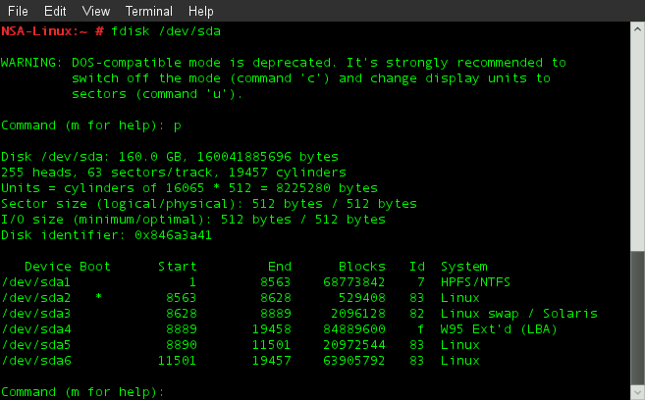
Viewing Partitions

Slide 15
File Systems - ext
In *nix, a file is the basic component for data storage.
*nix considers everything it interacts with as a file, even attached devices such as monitors, keyboards, and mice.
Partitions contain file systems, and file systems contain files and directories.
The native Linux file system is the currently ext file system (the extended file system)

Slide 16
File Systems
Current versions are ext3 or ext4
Both of these file systems use a journal to track changes being made to the file system, before they are made.
this improves reliability and reduces the chance of corruption after an forced shutdown, such as a power failure.
Many other file systems are supported by the Linux kernel. Most notable are NTFS and VFAT.

Slide 17
Navigation
You identify a specific a file or directory by specifying its path.
The path simply follows the branches of the file system to the desired file.
A forward slash (/) separates each file and directory name on a *nix system.
A path can be stated as either an absolute path or a relative path

Slide 18
Navigation
An absolute path always begins at the root directory ( / for *nix )
you then list all subdirectories to the destination file or directory using this same separator.
Examples:
/usr/local/bin
references this bin directory as a path starting from the root directory.

Slide 19
Navigation
A relative path begins navigation from the current directory.
a single dot refers to the current directory.
. or ./
For example, if our current working directory is /usr then
./local/bin
is a path relative to /usr

Slide 20
Navigation
dot dot (two consecutive dots) refers to the parent directory of the current directory.
.. or ../
You can use dot dot notation to navigate back through a directory structure as required.
../../
references the parent directory of the current directory's parent directory.

Slide 21
Navigation
The cd (change directory) command is used to navigate the *nix directory structure.
cd [DIRECTORY]
No options are available for the cd command
All Linux commands are case-sensitive.
A path can be absolute or relative:
cd ABSOLUTE_PATH
or
cd RELATIVE_PATH

Slide 22
Navigation
Examples:
cd /usr
use the absolute path to change to the /usr directory
cd ./local
use a relative path to change to the /usr/local directory
cd ../../
use a relative path to change to the / directory

Slide 23
Navigation
Two cases deserve special note
cd with no arguments changes to the current users home directory.
cd ~ references the current user’s home directory
note that the tilde ( ~ ) always references a user's home directory.

Slide 24
Navigation
When users log on, they begin navigating from their home directory.
ordinary users home directories are is usually located under the /home directory
the root user's home directory is /root
Use the pwd command to display the current location within the file system
Syntax: pwd [OPTION]
pwd stands for “print working directory”

Slide 25
Listing Directory Contents
Use the ls command to view information for files and directories
ls [OPTION]... [FILE or DIRECTORY]...
Options allow us to view the listing for a specific file or to see the contents of a specific directory

Slide 26
Listing Directory Contents
Common options to the ls command include:
-a lists all files, including hidden files
NOTE: hidden files start with a dot ( . )
-A lists all files, except the special of . and ..
-d lists directory entries instead of contents.

Slide 27
Listing Directory Contents
Common options to the ls command include:
-h when used with -l prints sizes in human readable format
-l prints out a long listing for each file, including permissions and file size.
-R recursively list subdirectories.

Slide 28
Directory Tree
*nix file systems are organized into a single tree-like structure
The *nix directory tree starts at the root directory which is denoted by the slash character ( / )
A directory is a special kind of file that can contain other files and directories
Directory files store the names of regular files and the names of other directories, which are called subdirectories

Slide 29
Linux / Directory
Typically contains only subdirectories.
Typical subdirectories include:
/bin
/boot
/dev
/etc
/home
/lib
/media
/mnt
/proc
/root
/sbin
/srv
/usr
/var

Slide 30
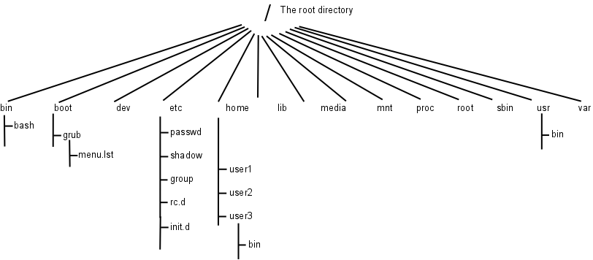
Linux Directory Tree

Slide 31
/bin Directory
The /bin directory contains binaries, or executables
Programs in this directory are needed to start the system and perform other essential system tasks
Programs in this directory may be used by normal users.
For example, bash, cp, ls, and some of the other commands we'll be exploring that are located in this directory

Slide 32
/boot Directory
The /boot directory contains the kernel images (the operating system)
Two files are key:
initrd
This is short for initial ram disk
Contains file required by the kernel before the root partition has been mounted.
vmlinuz
This IS the Linux kernel.

Slide 33
/boot Directory
This directory can also contain files required by the bootstrap loader
the boot loader is a utility that starts the operating system
GRUB and GNU GRUB, a.k.a Grub 2, are used by many GNU/Linux variants.
GRUB stands for GRand Unified Bootloader
Changes can be made to GRUB's configuration through the file:
/boot/grub/grub.cfg

Slide 34
/dev Directory
Files in /dev are device files that are used to access system devices and resources.
All devices are represented as files: hard disks, the mouse, printers, consoles, modems, memory, the CD-ROM drive, ...
For instance, the file sda1 will be located in this directory.
ls -l /dev/sda1

Slide 35
/dev Directory
Device files are divided into two major classifications:
block special (such as disks)
brw-rw---- 1 root disk 8, 1 May 29 09:58 sda1
character special (such as printers and modems, consoles, ...)
crw--w---- 1 root tty 4, 0 May 29 09:58 tty0

Slide 36
/etc Directory
The /etc directory contains configuration files for the system
Most of this directory is reserved for the system administrator, and it contains system-critical information stored in files:
passwd, the user database
shadow, the password database
group, the user group database
init.d and rc.d, scripts and directories of scripts to run when the system starts

Slide 37
/home Directory
Contains user home directories
Although users are restricted from reading information in other directories, a user owns and can access all files in their home directory
Users can grant or deny access to files within their home directory
Good practice to create a separate partition to hold the contents of this directory

Slide 38
/lib Directory
This directory houses shared libraries that programmers use to share / reuse code.
Using these libraries makes program smaller and faster.
Many files in this directory are symbolic links
A symbolic link is a reference to another file or directory and may reference other file systems.
hard links also reference other files or directories, but source and destination must reference the same file system.

Slide 39
/media Directory
Generic mount point for removable media like CD-ROM and USB flash drives.
For example, when you plug a USB flash drive into your computer, the system can:
detect the drive
create a temporary directory under /media to act as a mount point
attach the USB's file system to the directory tree using the temporary directory as the mount-point

Slide 40
/mnt Directory
A temporary mount point available to system administrators.
Prior to the addition of the /media directory, this directory often contained subdirectories such as cdrom and floppy.
These subdirectories were then used to attached removable file systems to the directory tree.

Slide 41
/proc Directory
The /proc directory occupies no disk space.
its contents are stored in a virtual file system allocated in memory.
Files in /proc contain information on:
the current system, such as cpu and memory.
processes currently running on the system.
As a regular user, execute the following commands and examine the results:
cat /proc/cpuinfo
cat /proc/meminfo

Slide 42
/root Directory
The /root directory is the home directory for the root user.
By default, no other user or group may access the contents of this directory.

Slide 43
/sbin Directory
This directory is reserved for executable files intended primarily for the system administrator
Programs that start the system, programs needed for file system repair, and essential network programs are stored here
cd /sbin ; ls -l

Slide 44
/tmp Directory
Many programs need a temporary place to store data during processing cycles
The traditional location for these files is the /tmp directory

Slide 45
/usr Directory
Stores most operating system files and programs
It might be advantageous to install this in its own physical partition

Slide 46
/var Directory
The /var directory holds subdirectories whose size often change
cd /var ; ls -l
These subdirectories contain files such as error logs and other system performance logs that are useful to the system administrator

Slide 47
Other bin Directories
/usr/bin
Used for standard software accessible to all system users
/usr/local/bin
Used for non-standard software accessible to all system users.
~/bin
Used for scripts and other executable files accessible to individual users.

Slide 48
Viewing Files
To create an file in Linux, type:
cat > filename
touch filename
To view or modify files in Linux, type:
nano filename
cat filename
vi filename

Slide 49
Wildcards
A wildcard is a special character that can stand for any other character, or, in some cases, a group of characters.
Wildcards are useful when working with several files whose names are similar or with a file whose exact name can’t be recalled.
*nix supports several wildcard characters including * and ?
* matches zero or more characters
? matches exactly one character.

Slide 50
Wildcards
For example:
> wildcard-test
ls -l *
ls -l w*
ls -l w?
rm wildcard-test

Slide 51
Creating Directories
Use the mkdir command to create directories:
mkdir [OPTION] DIRECTORY...
use the -m option to specify permissions as you create the directory. For example:
mkdir -m 700 testdir
use the -p option to force creation of parent directories if they do not exist:
mkdir -p ./parent/testdir

Slide 52
Removing Empty Directories
Use the rmdir command to remove a directory.
rmdir [OPTION]... DIRECTORY...
A directory must be empty before it can be removed using this command.
Use the -p option to remove empty parent directories at the same time.

Slide 53
Removing Files
Use the rm command to delete a file.
rm [OPTION]... FILE...
Using rm without options causes *nix to delete each specified file without warning.
By default the rm command does not remove directories
Use the -i option to have *nix issue a warning before deleting every file listed.
Use the -f option to have *nix suppress prompts and ignore non-existent files

Slide 54
Removing Directories
You may also use the rm command to remove nonempty directories by using the -r option.
This tells the rm command to remove a directory and everything it contains, including subdirectories
It even removes subdirectories of subdirectories
Be very careful with the rm -r command. It can quickly and permanently delete massive amounts of information.

Slide 55
Moving Files
Use the mv command to move a file
mv [OPTION]... SOURCE DEST
or
mv [OPTION]... SOURCE... DIRECTORY
The -i option will have the system prompt you before overwriting a file.
The -f option will cause mv to overwrite files without prompting
NOTE: Moving and renaming a file are the same operation.

Slide 56
Copying Files
Use the cp command to copy files:
cp [OPTION]... SOURCE ... DEST
The command copies the file(s) specified by SOURCE to the location specified by the DEST
If more than one file is specified as SOURCE, then DEST must be a directory

Slide 57
Copying Files
Use the -i option to have the system prompt before overwriting a destination file
Use the -r option to recursively copy directories
Use the -p option to preserve:
mode (permissions),
ownership,
and timestamps (to be discussed in a later module).

Slide 58
Copying Files
Example 1:
Assuming reminder is a file and duplicates is a directory, then the command:
cp reminder duplicates
will copy reminder to the duplicates directory. The new file will have the same name as the original file.

Slide 59
Copying Files
Example 2:
Assuming class_of_2009 is a file, then
cp class_of_2009 duplicates/classmates
will copy this file to the duplicates directory and name the copy classmates.

Slide 60
Copying Files
Example 3:
The command
cp memo_to_boss memo.safe
will create a copy of memo_to_boss in the current directory and name the copy memo.safe

Slide 61
Copying Files
Example 4:
Assuming pro1, pro2, and pro3 are files, then the command
cp pro1 pro2 pro3 duplicates
will copy all three files to the duplicates directory.
The new files retain the original names

Slide 62
Copying Files
Example 5:
the command
cp designs/* duplicates/
will copy all the files in the designs directory to the duplicates directory with all new files retaining the names of the originals.
All of these examples can be adapted to demonstrate the mv command. Take a few minutes to work through this.

